Slide 1
Software Engineering Project Wandering in the Woods

Slide 2
Introduction
Purpose:
Review case study requirements and document results.
Utilize agile methodology for the guide.
Agile design documentation is fluid and subject to change.
Define System Architecture model in the first iteration.
Develop design models as new data emerges.
Outline essential subsystems and components.
Document only crucial information for design team, following Agile standards.
This document serves as a working draft of the final blueprint.
Continuously enhance paper and framework with constructive feedback.

Slide 3
Introduction
Game Overview: "Wandering in the Woods"
Target Audience: Elementary school children (grades 3-5) and middle school students (grades 6-8)
Purpose: Simplicity with educational value and entertainment
For Grades 3-5:
Introduces core concepts
Presents "little data"
Encourages decision-making
Offers interactive challenges
For Grades 6-8:
Advanced version
Engages with larger and smaller datasets
Promotes significant decision impact
Enhances data manipulation skills

Slide 4
Process Model
Process Models for Business Enhancement:
Framework to analyze, manage, and improve internal processes
Streamlines procedures, boosts efficiency
Evolutionary Software Development Life Cycle:
Blends iterative, incremental game design
Creates adaptable, dynamic development framework
Evolutionary Development Model (EVO):
Aims for audience-driven products, cost reduction, risk management
Facilitates swift product improvements
Strategic Component Breakdown:
Phases based on client priorities
Enables modular, step-by-step development

Slide 5
Process Model
Concrete Outcomes & Trust Building:
Provides tangible results, fosters client trust
Emphasizes incremental delivery, transparency
Adaptability & Flexibility:
Responds to changing consumer demands, software evolution
Facilitates manageable updates, additions
Guiding Game Development:
Utilizes iterative development, incremental delivery
Adapts to client expectations, evolving project needs
Enhanced Game Development:
Improves efficiency, transparency, effectiveness
Achieves modularity, frequent releases, adaptation

Slide 6
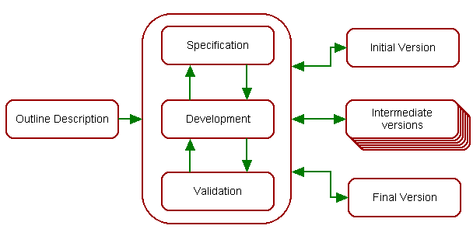
Process model
Figure 1: Process model for the system.

Slide 7
Use Case
Use Case Relevance:
Describes how users interact with the system
Guides design decisions and ensures user satisfaction
Use Cases:
"Launch Game and Start Playing"
"Begin Play"
"Play Game and Make Moves"
"Choose Stage"
"View Game Statistics"
"Replay Game"
"Exit Game"
"Move Diagonal"
"Move Randomly and Place Characters"
"Change Grid Size"
"Play Challenges"
"Test Wandering Methods"

Slide 8
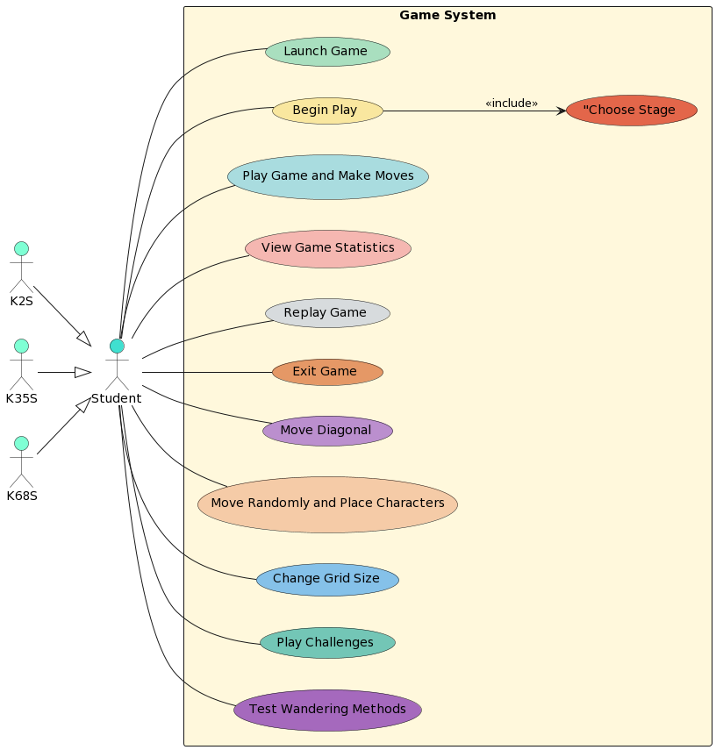
UML Diagram – Use Case Diagram
Figure 2: Use case Diagram for the system.

Slide 9
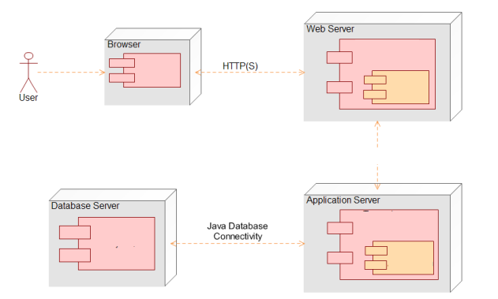
UML Diagram – Deployment Diagram
Figure 3: Deployment Diagram for the system.

Slide 10
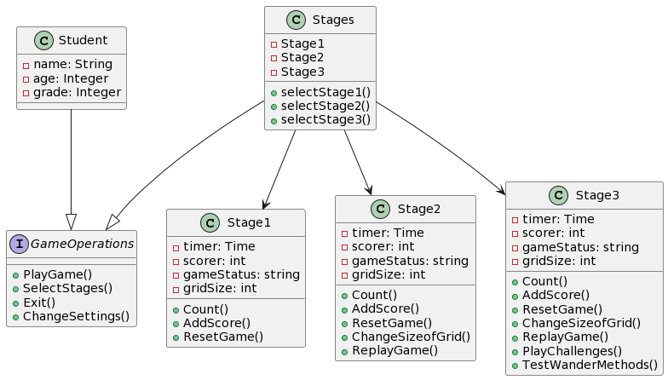
UML Diagram – Class Diagram
Figure 4: Class Diagram for the system.

Slide 11
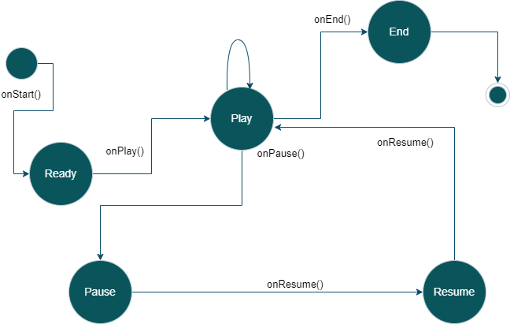
UML Diagram – State Diagram
Figure 5: State Diagram for the system.

Slide 12
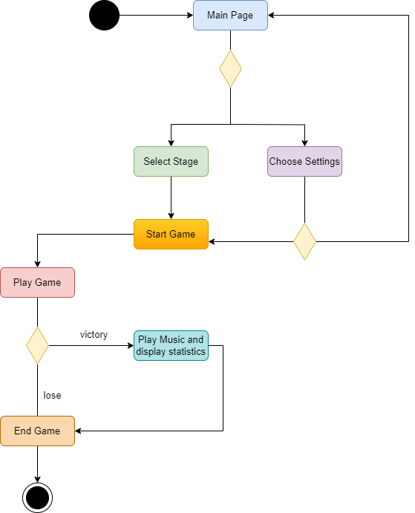
UML Diagram – Activity Diagram
Figure 6: Activity Diagram for the system.

Slide 13
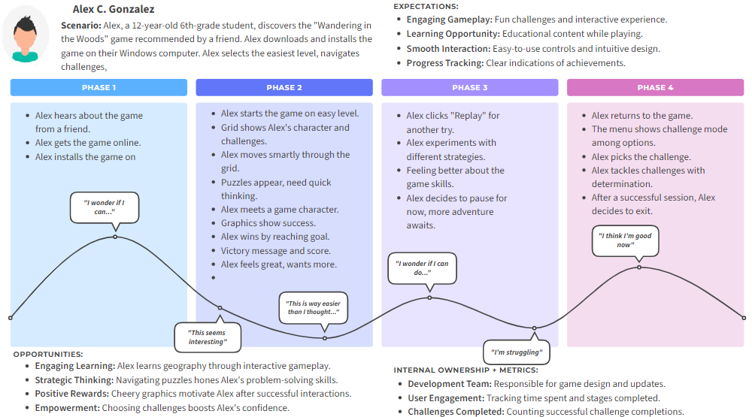
Customer Journey map
Customer Journey Maps:
Brands comprehend customer interactions
Examines operations from customer perspectives
Comprehensive Understanding:
Visualizes customer journey end-to-end
Depicts intricate customer relationships
Insights for Improvement:
Identifies consumer problems and enhancements
Uncovers emotions and thoughts at each touchpoint
Refining Strategy & Experience:
Understands consumer demands, perceptions
Enhances strategy, elevates client experience
Design Team Advantage:
Aligns expectations with brand offerings
Drives iterative, customer-centric design

Slide 14
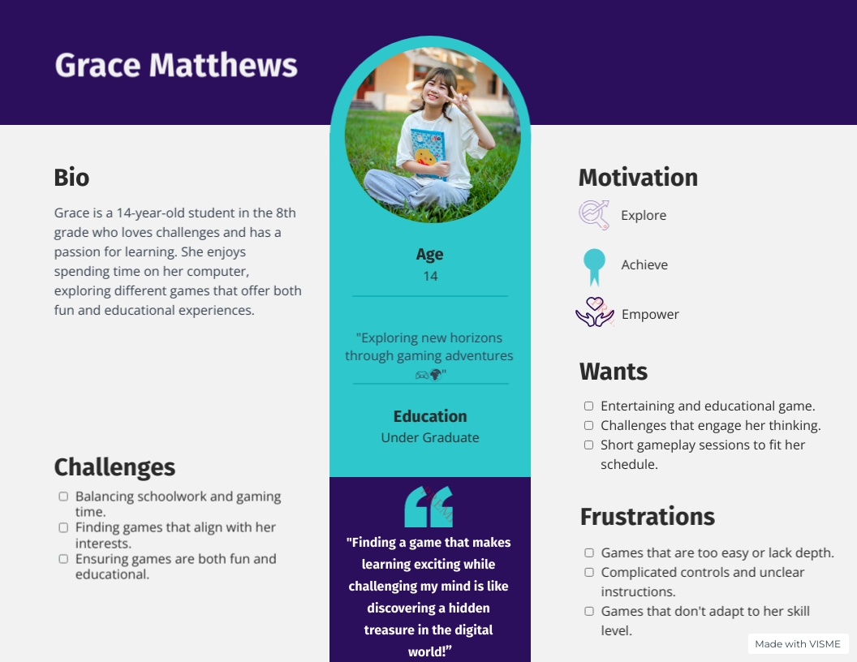
Persona
User Personas: Profiles aiding designers to connect with diverse users.
Persona Creation: Meet Grace - 14th-grader with academic struggles, gaming interest.
Design Focus: Addressing challenges for Grace's gaming experience.
Interface: Prioritize simplicity, avoid complexity issues.
Benefits:
Engagement: Game aligned with Grace's interests for active participation.
Learning: Simple design fosters effective learning and problem-solving.
Personalization: Tailored approach enhances user satisfaction.
Conclusion: User personas bridge design-user expectations gap.
Empowerment: Understanding users leads to engaging, satisfying, and educational products.

